Slide 1
SearchRx : An International Drug Label Search Tool
Harvard University, Extension School​
CSCI E-599 Software Engineering Capstone Spring 2023
Team
Alex Giannini
Bobby Cavezza
Cole Crawford
Lucy Zhang
Peter Woo
Yusheng Jiang
Customer
David Edelen
Teaching Staff
Peter Henstock
Simili Abhilash

Slide 2
Overview
An open-source web application that provides search and comparison of pharmaceutical drug labels across multiple countries
Includes customized features to solve pain point of users to compare and analyze the drug labels
Notes:
An open-source web application that provides search and comparison of pharmaceutical drug labels across multiple countries, including US, EU, Australia and Canada

Slide 3
Problem Summary
Drug Labels are required by a variety of Regulatory Bodies
No tools exists to analyze sections from different countries
Primary goal
Features introduced to achieve this goal
Primary users
Notes:
Drug Labels are required by a variety of Regulatory Bodies across different countries (US, EU, Australia, Canada)
While there are some searchable government databases, no country provides adequate tools for search and analysis drug labels
SearchRx’s primary goal is to help users more clearly understand the differences between regulatory agencies
features introduced to solve the pain point: section search, comparison, customized user upload, version history
Primary users are public health professionals, academic researchers and pharmaceutical companies

Slide 4

Demo

Slide 5
Currently deployed and available at https://searchrx.org

Slide 6
Automating the Loading of Drug Labels
Supported Countries:
US - Food and Drug Administration (FDA)
EU - European Medicines Agency (EMA)
Australia - Therapeutic Goods Administration (TGA)
Canada - Health Canada (HC)

Slide 7
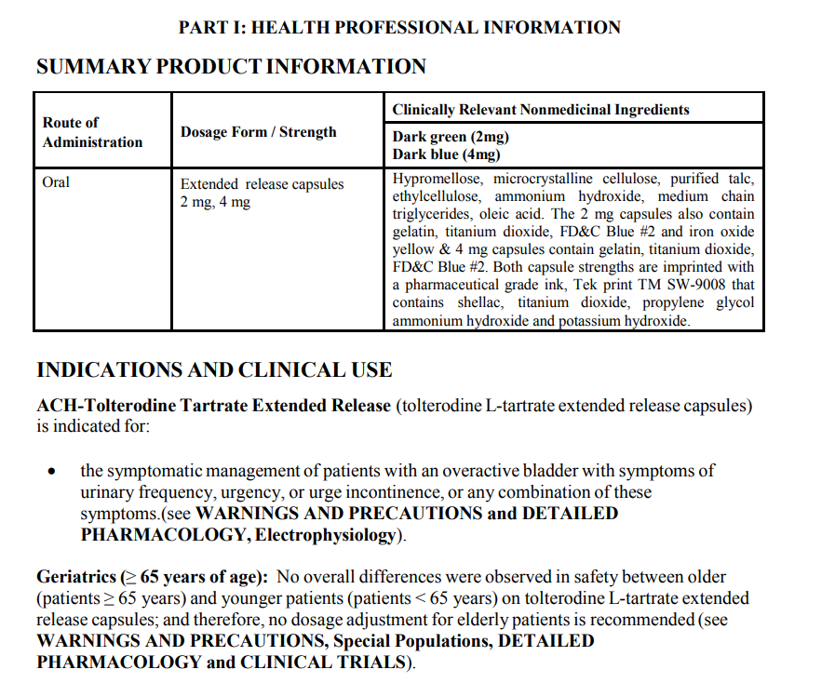
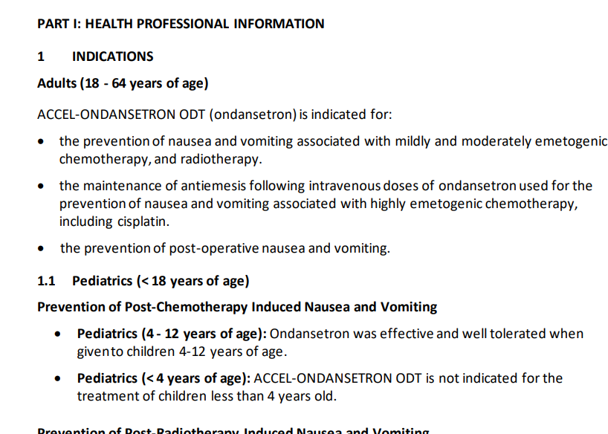
Sample Drug Labels

Slide 8
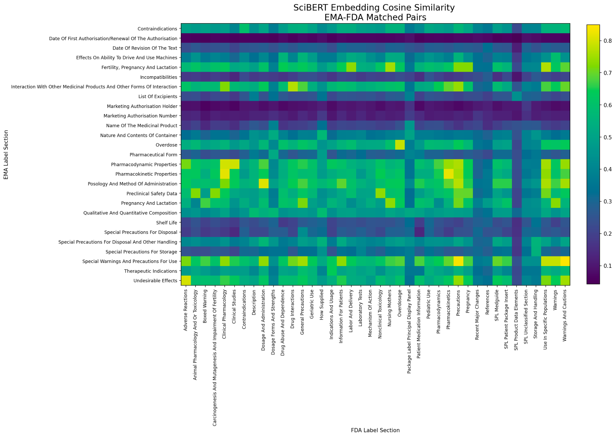
Challenges with Parsing Labels from Multiple Countries
Variations in metadata organization
Diversity of section titles containing the same content
Redundancy of sub-sections
Difference in format (PDF, XML, json)

Slide 9
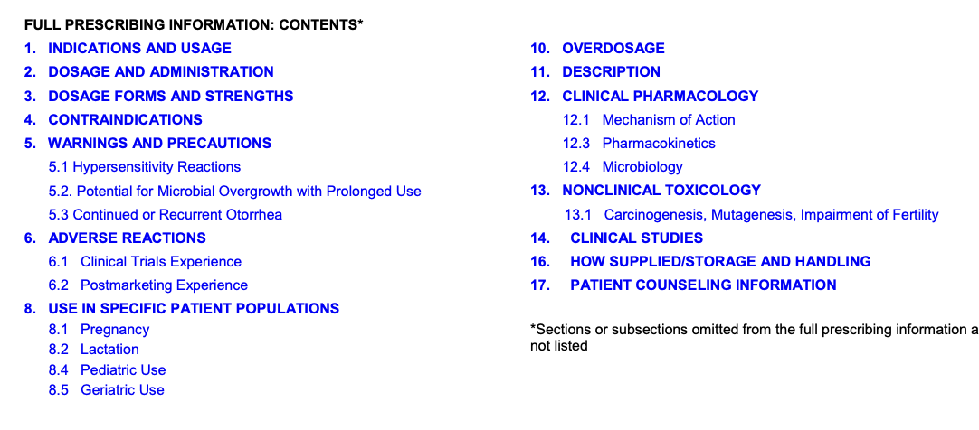
Our Strategy
Example of the index of FDA label
Manually mapping the meta categories for labels from all countries
Using 17 main categories in FDA labels
Included 27 additional categories

Slide 10
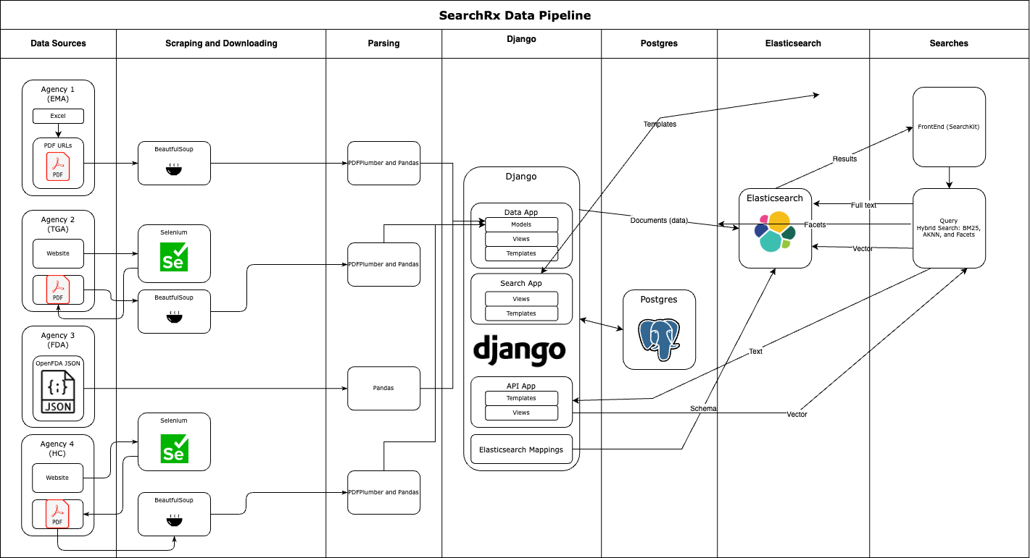
Data Pipeline
Notes:
Thanks Jason
Just to situate where we are in our data processing pipeline, this is an overview of how data flows through SearchRx. We have talked about the first 3 or 4 sections - identifying data from agency sources, scraping and downloading the data, and parsing it and inserting the data into our database. I’m going to cover the next few steps - vectorizing our data and performing semantic searches.

Slide 11


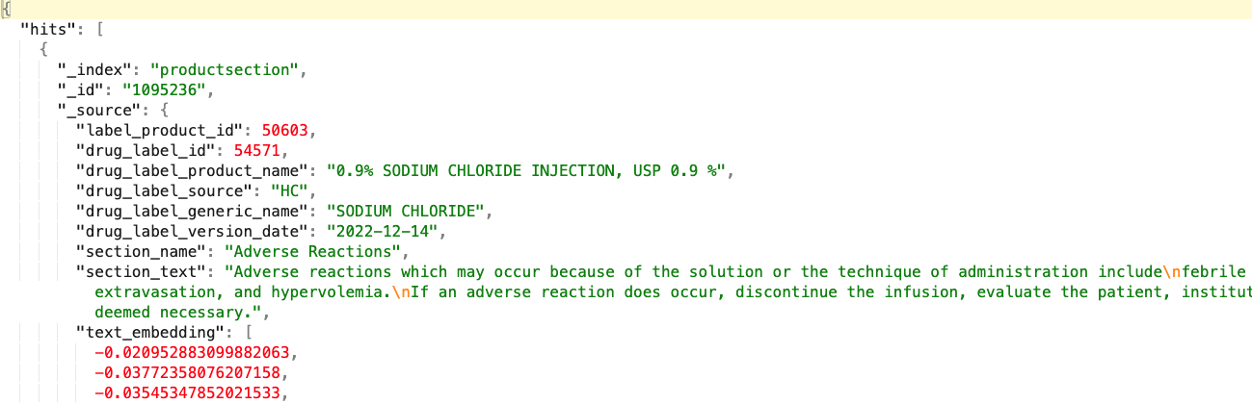

Semantic Search
Notes:
A key requirement for our project was to provide a search experience that could be fast, powerful, and flexible.
We looked at a couple different of ways to tackle this. Like the Doyen team just mentioned, we first did prototyped using Postgres’ full text search capabilities. Switching to Postgres was faster than the previous MariaDB database used in the DLE application, but we also thought that was going to be difficult to scale as our dataset increased in size and as we added additional features like faceting.
Postgres also didn’t cover the “powerful” requirement, which we ultimately decided to mean that we needed to support semantic search. Traditional search metrics like TF-IDF or BM25 search on keywords scaled based on frequency, while semantic search tries to find results that include similar concepts whether or not there are keyword matches. For example, our client David wanted to be able to run a search for a query like "brain bleeding," and get results back for documents that contain “cerebral hemorrage” because the concepts are very similar, even if neither "brain" nor "bleeding" are in the target document.
We decided to implement semantic search using Elasticsearch. Elastic is a robust industry favorite for search and can handle millions of documents with fast responses. Out of the box, Elastic uses a BM25 algorithm, but about a year ago Elasticsearch added semantic search using an approximate nearest neighbors algorithm. So we also provide KNN as a search option.
In the data and search pipeline highlighted here, we
Ingest data into Django during scrapes. This is what Peter and Jason ran through. We store all the drug label metadata in Postgres, including the full section text
We then produce text embeddings using the full section text. These are used for the semantic search. Semantic search uses vectors to represent documents. These vectors are high-dimensional arrays of floats, which allows search engines to quickly perform vector math and find similar documents or other operations. Different algorithms produce different lengths and densities of vectors, and the quality of the results is highly dependent on the corpus the model was originally trained on so that it can accurately transform documents similar to that corpus. We used a HuggingFace sentence transformers model from Microsoft that starts with a BERT model trained on PubMed abstracts and PubMedCentral full text articles, and then fine-tuned on the MS-MARCO (Machine Reading Comprehension) dataset.
Generating vectors takes a long time - at one point we were estimating weeks, but we were able to speed things up and get that time down to hours instead. Vectorizing the FDA labels took the longest but still finished in under a day. Because of this, we store all the vectors in Postgres so we can easily recreate the Elasticsearch index.
We then index all the data into Elasticsearch using a custom schema so that Elastic understands how to use our text embeddings

Slide 12
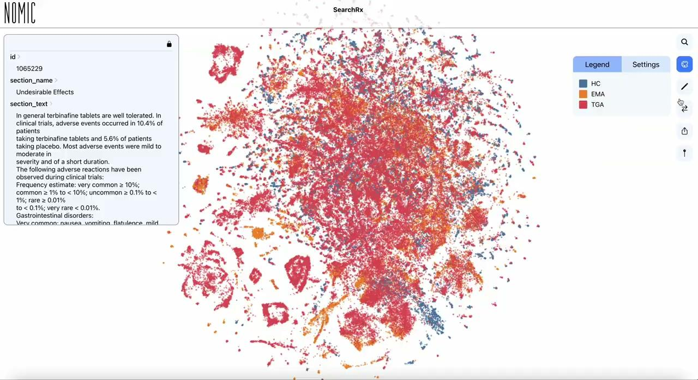
Text Embedding Visualization
Notes:
So what sort of functionality do these vectors provide? Their most important use, as Bobby demonstrated, is to improve our search engine capacities. But they also provide a way for us to explore how various drug label sections are related. Jason highlighted a cosine similarity matrix when he was talking about parsing labels from different countries and explaining how some section types have strong cohesion and other look a lot like other sections. The visualization on this page created with the NomicAI platform takes the PubMedBERT vectors and maps them from a high-dimensional space into a 2D space. It plots vectors that are similar next to each other, and colors them based on metadata.
Play
Here the vector dots are colored based on the agency. We can change it to the section name instead to see how sections affect how vectors cluster. There are some very clear clusters for specific sections: Undesirable Effects, Date of First Approval, another for Special Precautions for Disposal. Sometimes there are oddities - here I zoomed into this red dot in the middle of another cluster, it’s there because it includes very similar language even though it’s a different section type. But there are also a lot of sections which don’t cluster together well, which gestures at the problem Jason outlined - doing text classification of the sections using the vectors wouldn’t have been super accurate.
You can also use NomicAI to search for terms - here, all the sections with the word “Advil” cluster together

Slide 13
Architecture Overview​
SearchRx deployed on AWS
CI/CD Pipeline implemented
Elastic Search, Postgres, Django
ECS, RDS and EC2 deployed with cloudformation
GitHub w/Git for Version Control
GitHub Actions Pipeline automatically deploys changes
Django Application Image deploys within ~10 minutes
CFN for is automatically deployed when scripts modified

Slide 14
What We Feel Good About
Custom Label Upload
Inclusion of Additional Regulatory Agencies
Semantic Search
Data Visualization Feature
Search Experience including section search and comparison
Data Ingest and processing pipeline
Quality of Data
Infrastructure As Code Scripts and Pipeline

Slide 15
What We’d Love To See in the Future
Inclusion of Additional Regulatory Agencies
Data Pipeline Optimization
Additional Testing
Additional API Functionality
UK, Japan, Brazil, China
Initial deployment could be sped up
Separate container for updates
Currently Pytest and Playwright are run on deployment
However, more test cases could be added
API returns metadata for searches
Individual label section data could be included

Slide 16
Questions

Slide 18
Appendix

Slide 19
Data Pipeline
Notes:
Thanks Lucy.
Just to resituate things, this is a quick overview diagram of the data processing and access pipeline for SearchRx. We have talked about the first 3 or 4 sections - identifying data from agency sources, scraping and downloading the data, and parsing it and inserting the data into Django. I’m going to cover the next few steps - vectorizing our data and performing semantic searches.

Slide 20
Text Embedding Visualization
Notes:
I know that talking about search vectors can be a bit dense and hard to follow. While we hope that users can simply use the search and not need to think about the underlying architecture, I found that a quick experimental visualization was also helpful to understand how the vector search works. I created this visualization using NomicAI and our PubMedBERT vector data. It flattens the very high-dimensional vectors into a 2D grid and plots vectors which are similar to each other next to each other and colors them based on metadata.
Play
Here the vector dots are colored based on the agency. We can change it to the section name instead to see how sections affect how vectors cluster. A cluster for Undesirable Effects, another for Date of First Approval, another for Special Precautions for Disposal - that’s a TGA label, and if you zoom in the red dot in the middle includes very similar language. But there are also a lot of sections which don’t cluster together well, which gestures at the problem Jason outlined - doing text classification of the sections using the vectors wouldn’t have been super accurate. You can also use NomicAI to search for a term - showing here that all the sections with the word “Advil” cluster together

Slide 21
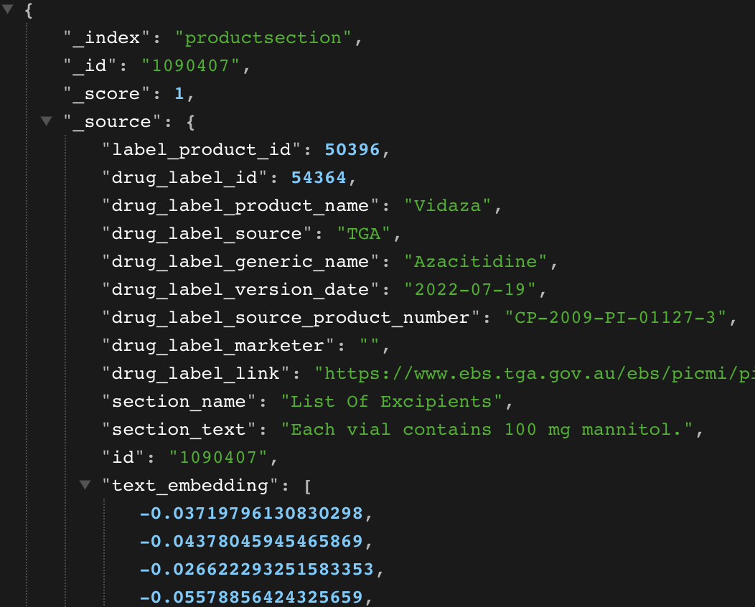
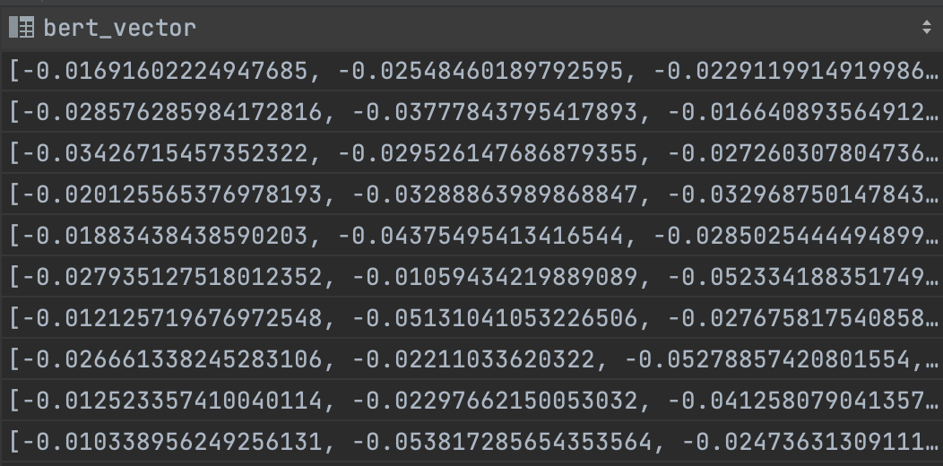
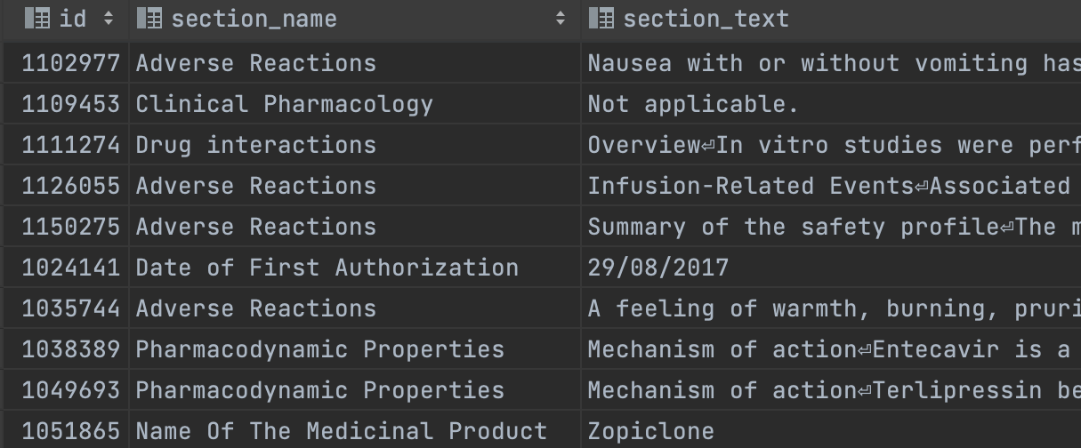
Semantic Search
PubMedBERT: vectors
Elasticsearch: denormalized, indexed documents
Django / Postgres: original text
Notes:
A key requirement for our project was to provide a search experience that could be fast, powerful, and flexible.
We looked at a couple different of ways to tackle this. We first did a small prototype using Django’s SearchVectorQuery fieldtype which leverages Postgres’ full text search capabilities. Switching to Postgres was much faster than the previous MariaDB database, but this was going to be difficult to scale as our dataset increased in size and complexity and as we added additional features like faceting.
Postgres also didn’t cover the “powerful” requirement, which we ultimately decided to mean that we needed to support semantic search. We touched on this last time - but traditional search metrics like TF-IDF or BM25 search on keywords, while semantic search tries to find results that include similar concepts. For example, our client wanted to be able to run a search for a query like "brain bleeding," and get results back for documents that contain “cerebral hemorrage” because the concepts are very similar, even if neither "brain" nor "bleeding" are in the target document.
As mentioned in our milestone 2, we decided to implement semantic search using Elasticsearch. Elasticsearch added this feature about a year ago and has been steadily improving it, and as of a couple weeks in Elastic 8.7 they added a query_vector_builder so that you can perform your vectorization steps directly within Elastic, provided that you pay them for the Machine Learning license of course. Our pipeline however is a little different:
Data pipeline
Ingest data into Django during scrapes. We store all the DL metadata in Postgres, including the full section text
We then produce text embeddings using the full section text. These are used for the semantic search. Semantic search uses vectors to represent documents. These vectors are high-dimensional arrays of floats, which allows search engines to quickly perform vector math and find similar documents or other operations. Different algorithms produce different lengths and densities of vectors, and the quality of the results is highly dependent on the corpus the model was originally trained on so that it can accurately transform documents similar to that corpus. We used a HuggingFace sentence transformers model from Microsoft that starts with a BERT model trained on PubMed abstracts and PubMedCentral full text articles, and then fine-tuned on the MS-MARCO (Machine Reading Comprehension) dataset.

Slide 22
id | source | product_name | section_name | section_text
54571 | HC | 0.9% SODIUM CHLORIDE INJECTION, USP 0.9 % | Adverse Reactions | Adverse reactions which may occur because of the solution or the technique of administration include febrile response, infection at the site of injection …
58951 | EMA | Lopinavir/Ritonavir Mylan | Adverse Reactions | Summary of the safety profile The safety of lopinavir/ritonavir has been investigated in over 2600 patients in Phase II-IV clinical trials
id | section_text | bert_vector
54571 | Adverse reactions which may occur because of the solution or the technique of administration include febrile response, infection at the site of injection … | [-0.020952883099882063, -0.03772358076207158, -0.03545347852021533, -0.03819845023482053, -0.003719796577020368, …]
58951 | Summary of the safety profile The safety of lopinavir/ritonavir has been investigated in over 2600 patients in Phase II-IV clinical trials | [-0.026266641680619072, -0.02215060431110078, -0.017599875038711896, -0.04690653557020431, 0.0017346081883592597,…]

Slide 23
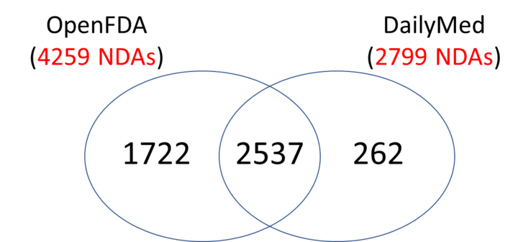
Challenge: OpenFDA vs DailyMed
Switched from DailyMed (XML) to openFDA (JSON)
OpenFDA has over 200k labels containing all versions
OpenFDA has more unique labels than DailyMed
DailyMed API doesn’t provide application numbers of ANDA labels
NDA: New Drug Application
ANDA: Abbreviated New Drug Application (generic)

Slide 24
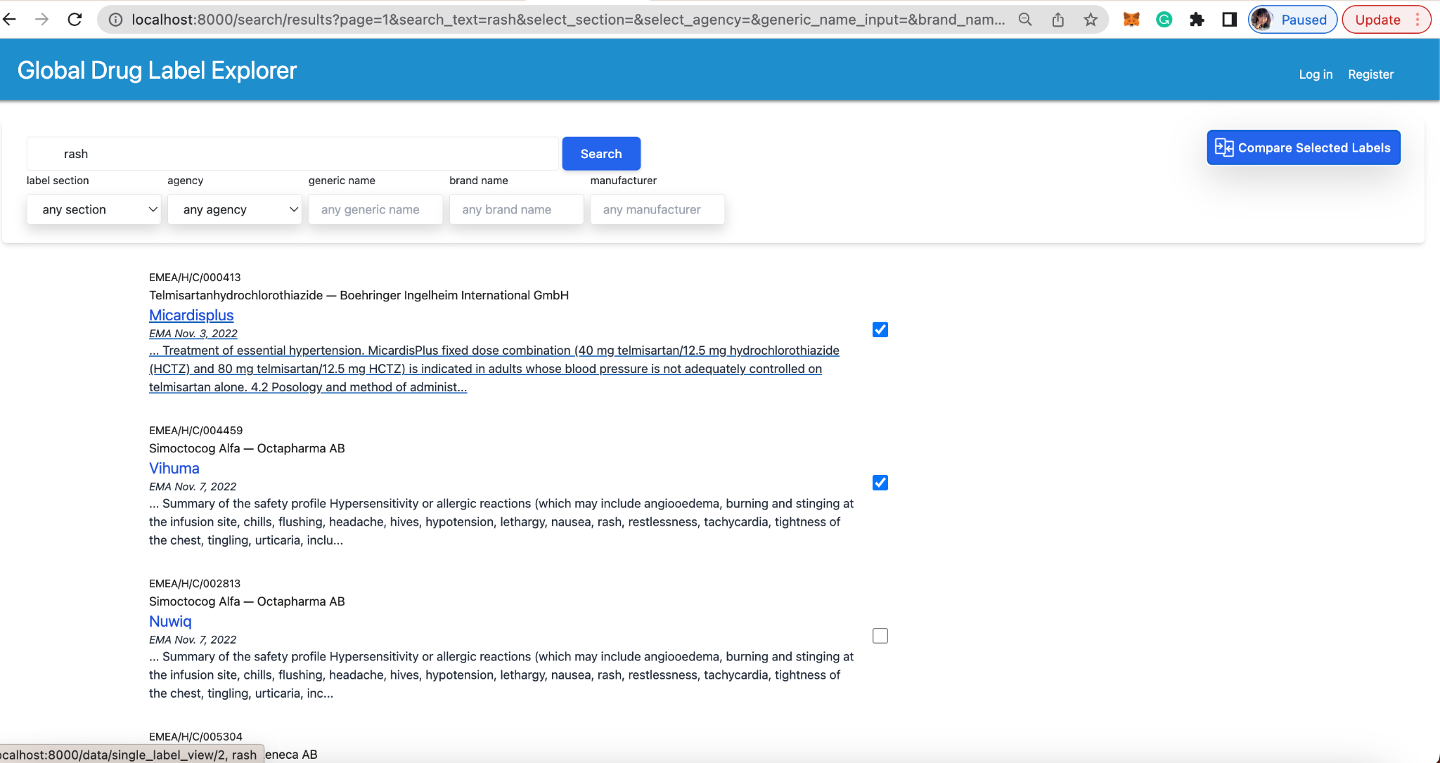
UX evolution on ease of use for customer
Notes:
Feedbacks: UX slides - make it more clear and readable. Use high level bullets highlighting the key points, along with screenshots

Slide 25
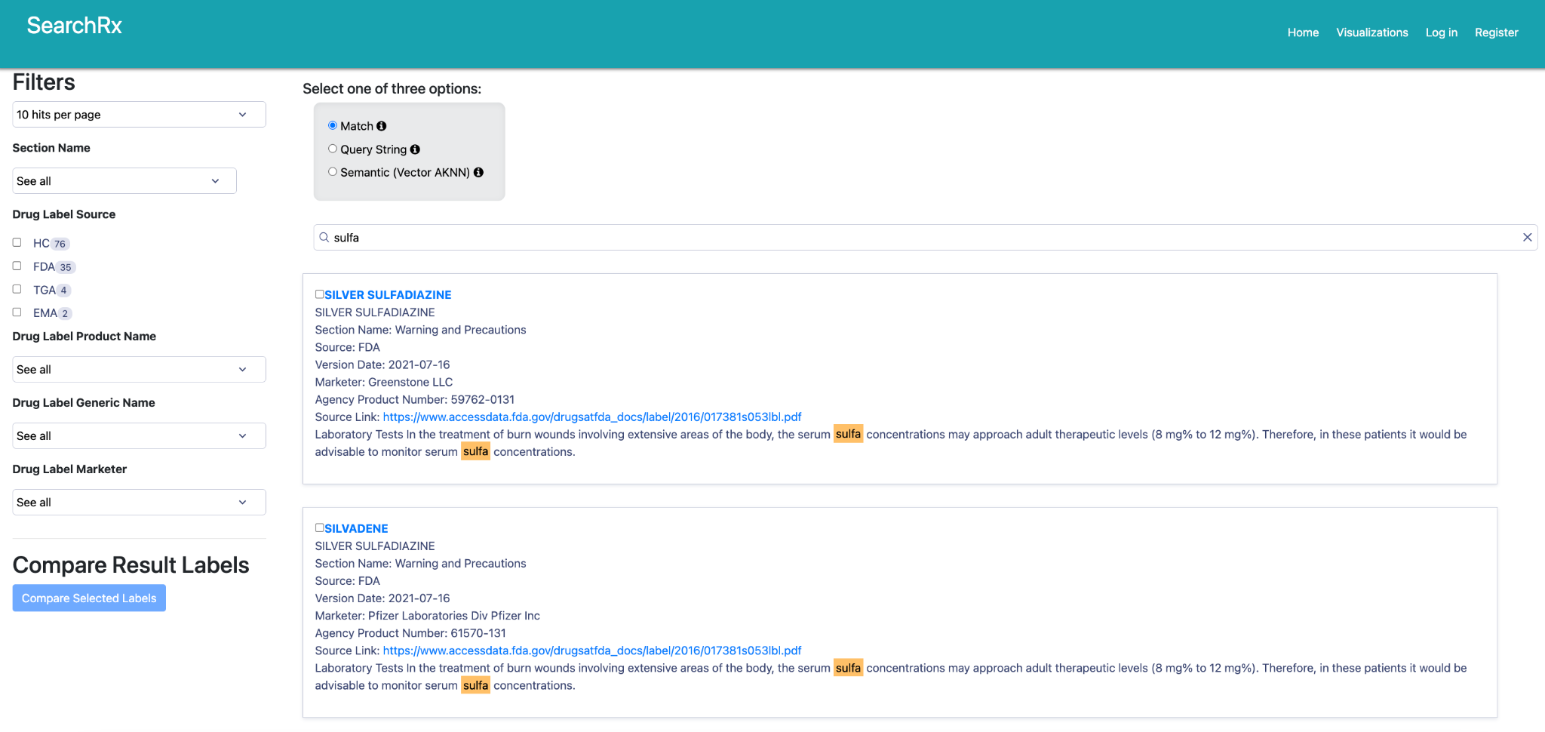
UX evolution on ease of use for customer
Notes:
Feedbacks: UX slides - make it more clear and readable. Use high level bullets highlighting the key points, along with screenshots

Slide 26
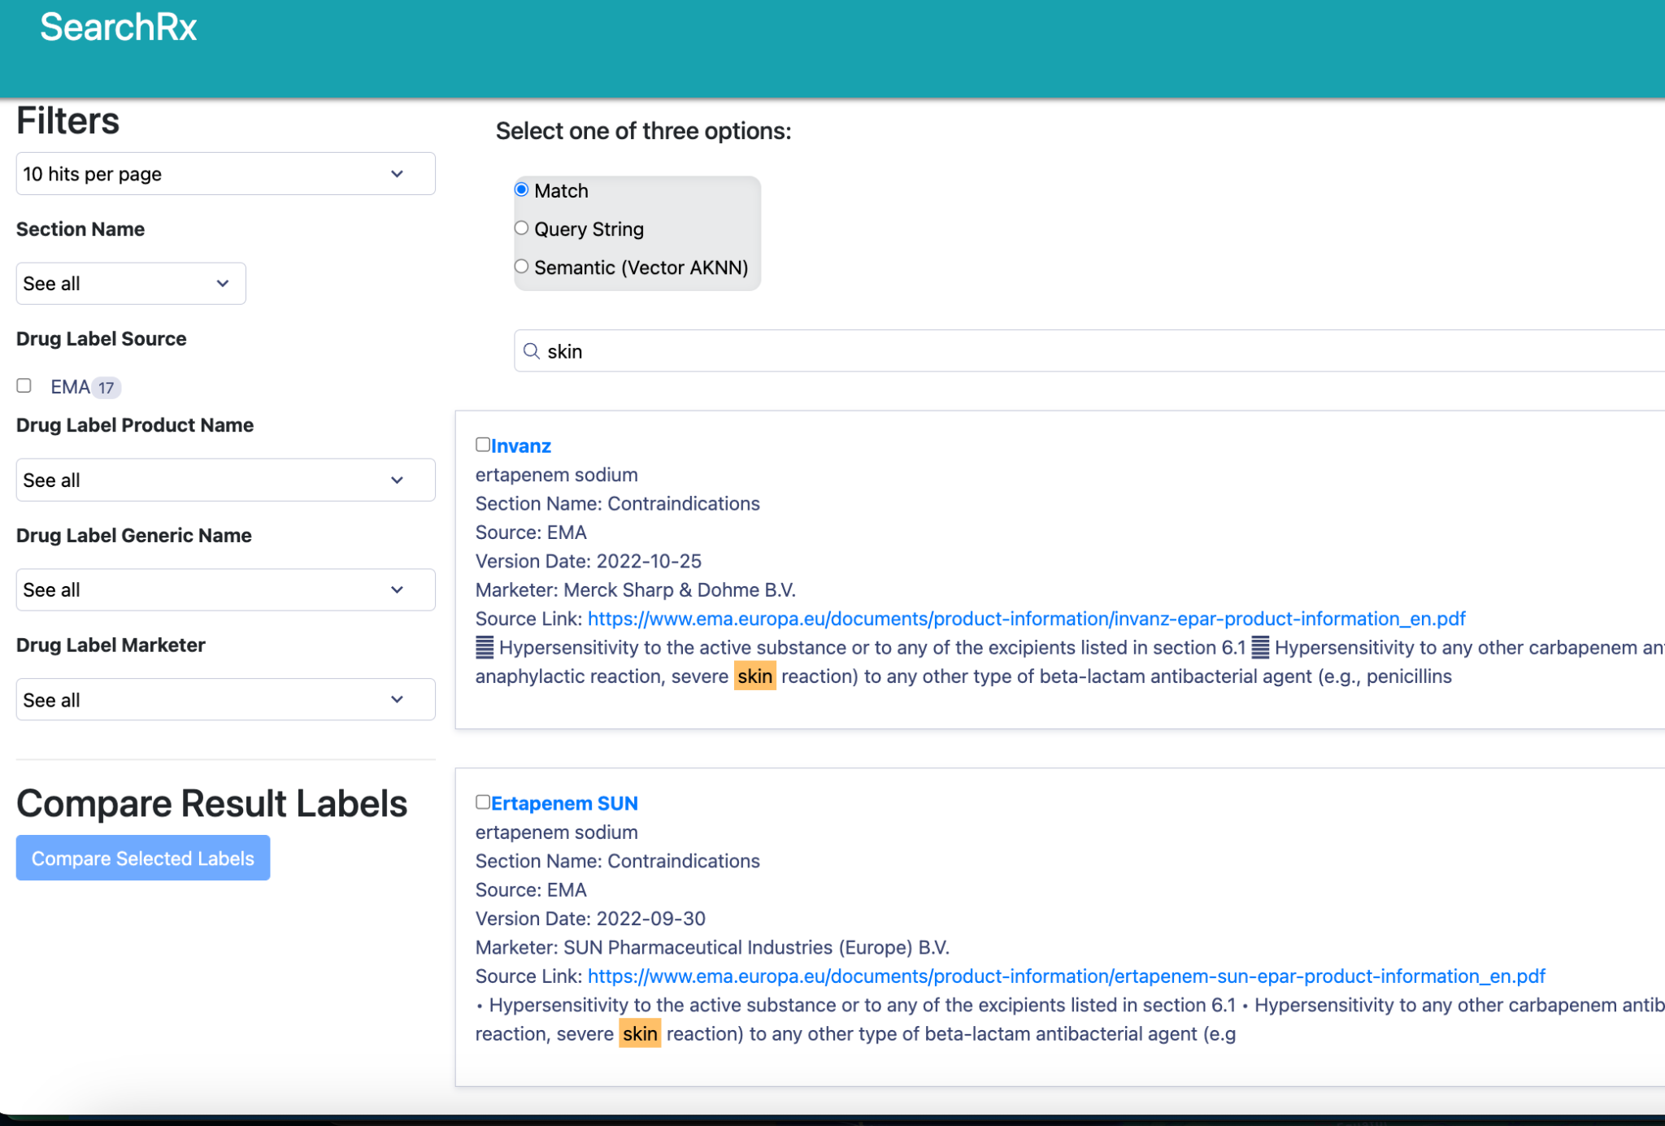
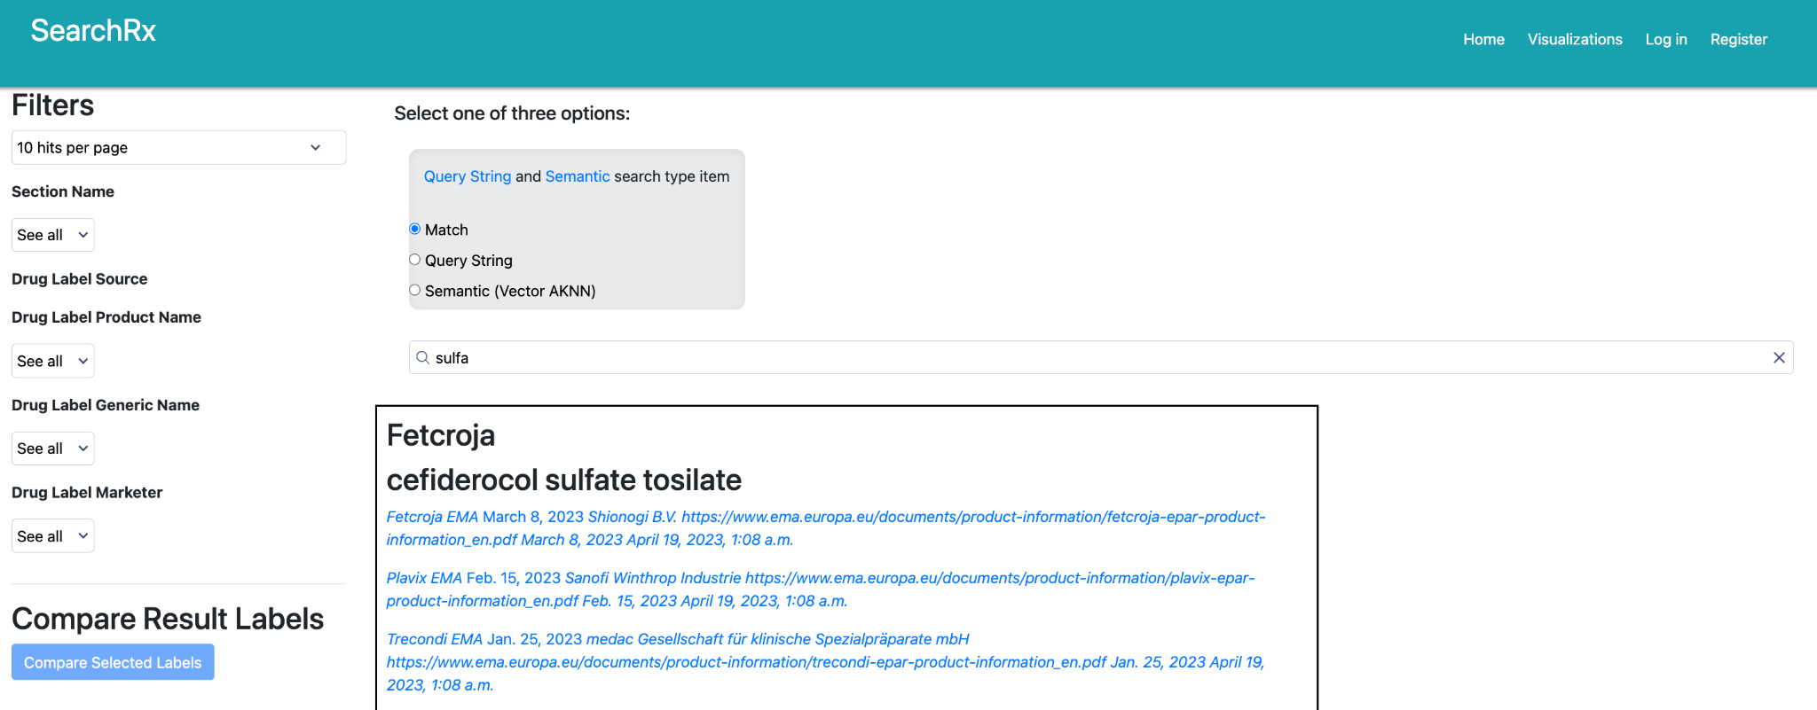
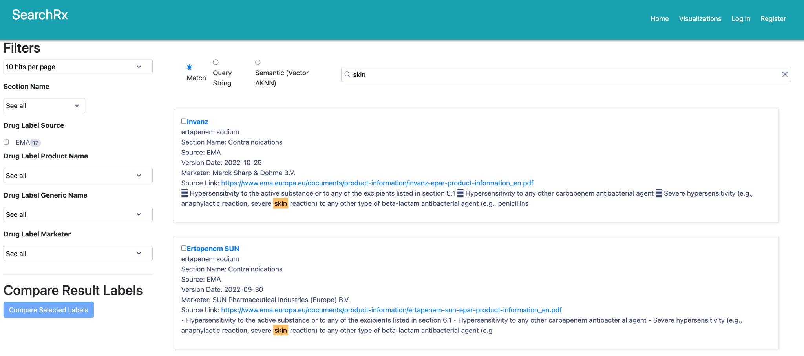
UX: the evolution of search result
Harvard DCE
Notes:
Rich snippets in card view(search result page): The current search result now displays rich snippets, which provide additional information about search results, such as links, . This helps users make more informed decisions before clicking on a result.
Overall, these UX changes aim to make search functions more user-friendly and efficient, allowing users to find the information they need faster and with less effort.

Slide 27
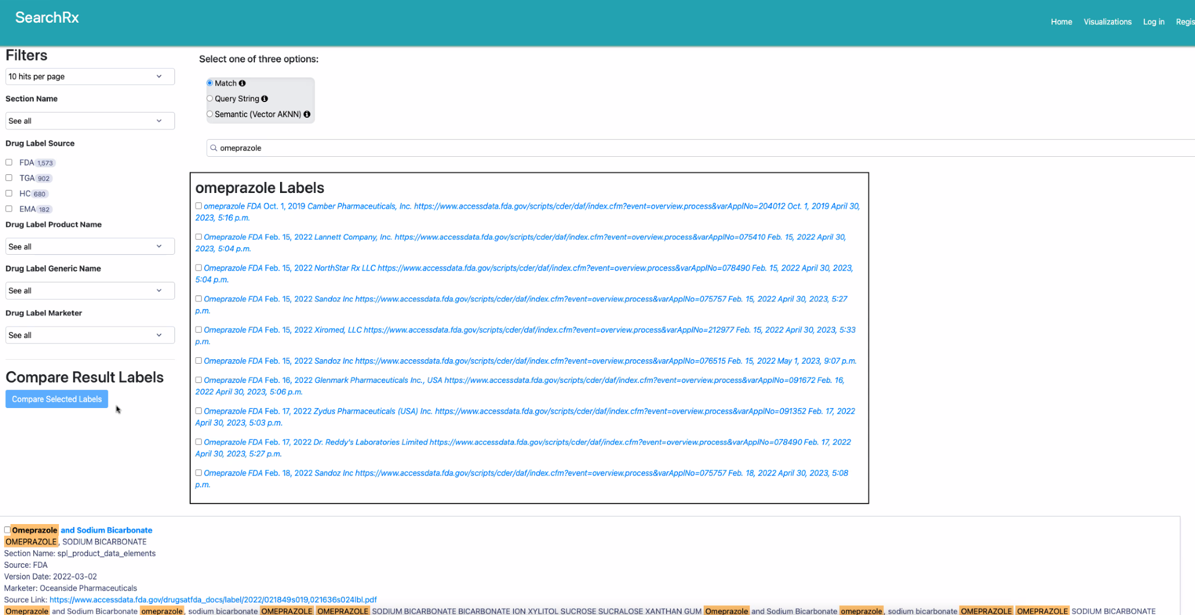
CUJ based feature adds-on
Harvard DCE
Notes:
Customized Filters: Search function now offer filters and database options to help users refine their search queries and find specific types of results. A simple use case is to let users type their search queries. The customized filters and selection in dropdown helps users find relevant results faster and reduces the chances of spelling errors.

Slide 28
UX: the evolution of search result
Harvard DCE
Notes:
Rich snippets in card view(search result page): The current search result now displays rich snippets, which provide additional information about search results, such as links, . This helps users make more informed decisions before clicking on a result.
Overall, these UX changes aim to make search functions more user-friendly and efficient, allowing users to find the information they need faster and with less effort.

Slide 29

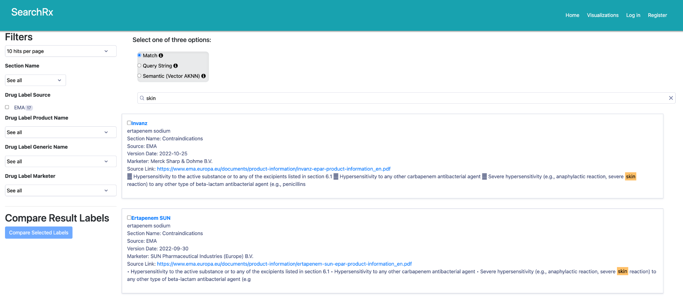
UX Overview
Landing page search
Harvard DCE
Notes:
Simplified Navigation: The landing page has streamlined navigation to make it easier for users to find what they need quickly.
This includes introducing filter in dropdowns and grouping similar features together.
At same time, several key changes were made. For example, the team met with the customer and discussed the various elements weekly to choose the right customer experience. (vertical and horizontal view in the comparison page) Further, the team worked to improve the landing result page, adding different components. An updated logo was created and a different layout in search results implemented. The visual layout is customized to different types of user needs based on search type. The overall look and feel were changed to provide a more ease of use and smooth look.

Slide 30
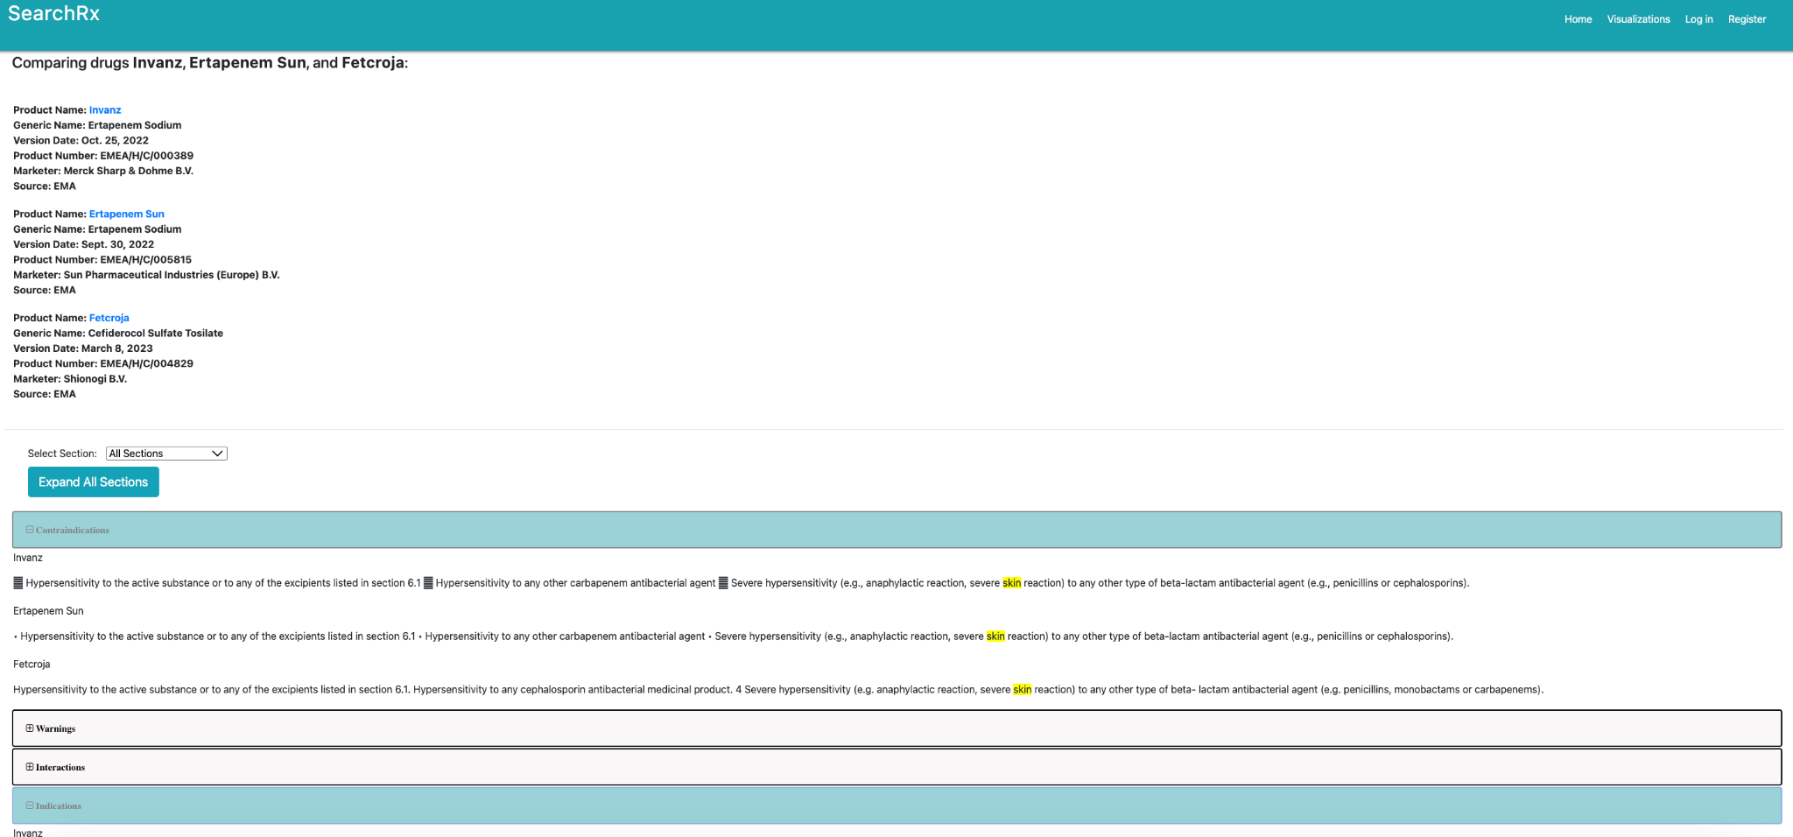
UX: Compare result
Harvard DCE
Notes:
Layout Optimization: With the rise of interface usage, the result page and compare page have optimized user experience for ease of use as well as visual clearness to easily identify the content user was looking for. This includes user-friendly design, faster load times, and simplified navigation. In addition, the comparison page was developed to allow users to compare labels more easily, the result page view is easy to use to see different results endlessly in vertical view instead of horizontally.

